Slide 1
Computer Networks and Design
UNIT-IV
NETWORKING TOOLS AND TECHNIQUES
Simulation method for designing multimedia networks – Determining remote bridge and router delays – Network base lining as a planning tool

Slide 2

COURSE OBJECTIVE’S
To recognize the principles of the big picture of computer networks.
To understand the networking environment.
To know the importance of VPNs.
To convey the availability of tools and techniques for networking.
To discuss about evolving technologies in networks.

Slide 3
COURSE OUTCOME
CO1 - Understand the principles of networks.
CO2 - Interpret LAN concepts and design.
CO3 - Gain knowledge in evolving technologies.
CO4 - Clearly outline the logic behind VPNs.
CO5 - Know the importance of tools and techniques in building a network.
CO6 - Understand the underlying working concepts of a real-time network.

Slide 4
A Simulation Method for the Design of Multimedia Networks
Three basic phases
Preparation phase, describes how to define goals in measurable terms.
Baseline phase, information concerning data capture and the validation of such data are presented.
Delta phase, During this phase, changes are applied to the baselined network, after which the results are analyzed and summarized through information presented in the three phases.

Slide 5
Determining Remote Bridge and Router Delays
Focuses attention on techniques one can use to determine a number of quantitative metrics involved in client/ server computing via bridges and routers.
Queuing theory to illustrate various performance metrics associated with interconnection geographically separated LANs via remote bridges or routers.
Illustrates how to project queuing delays, of far more importance is the presentation of how one can use queuing theory to answer a classic network design problem. That problem is the appropriate selection of a WAN operating rate to interconnect two geographically separated LANs

Slide 6
Network Baselining as a Planning Tool
Core set of popular communications tools one can consider using to facilitate the network design process.
Examples of planning tools
Triticom, Inc.’s SimpleView, an easy-to-use SNMP management platform
NetManage’s Newt, a program that provides statistics on network activity associated with individual users
Ethervision, a program from Triticom that provides statistical information on individual Ethernet network users as well as information concerning the overall activity of the network
Foundation Manager, a product of Network General Corporation, which is now part of Network Associates, and which provides information on both local and remote networks via SNMP.

Slide 7
A Simulation Method for the Design of Multimedia Networks
Multimedia networks and the tools that represent them are complex
Simple examples are often insufficient to impart an understanding of the process or methodology that a network designer needs to use to achieve accurate simulation results.
Describes one such methodology, which is applicable to the use of tools for the design and analysis of multimedia networks that carry voice, video, and data.
provides the structure and approach that are missing from the user manuals

Slide 8
THE MODELING PROCESS
Complexity requires a great deal of organization in data collection, model validation, and analysis of results.
A defined process increases confidence in the results by increasing organization and thereby managing complexity.

Slide 9
Aspects of simulation
Important data that will be required
Means for obtaining this data
Suggestions for modeling the data
Possible interpretations of results
How the modeling procedure might be segmented into tractable units

Slide 10
Three basic phases
Phase I: Preparation
Phase II: Baseline
Phase III: Delta
Phase I tasks include:
Goals.These must be stated in measurable and clear terms.
Data collection.The topology and traffic of the existing network is captured.
Phase II tasks include:
Capture. The collected data is captured in the model.
Validation. The captured model is validated.
Phase III tasks include:
Delta. Changes are applied to the baselined network.
Analysis. The results are analyzed and summarized.

Slide 11
PHASE I: PREPARATION
Includes the definition of goals and the collection of topology and traffic data for the baseline network.
The first task is identifying the goals.

Slide 12
Identifying Goals
A simulation should have clearly defined goals. For the hypothetical case discussed here have two principal goals:
The first is to develop a validated baseline model of the network in its current configuration
the second is to model the introduction of an asynchronous transfer mode (ATM) backbone.

Slide 13
Summary of the modeling strategy entails the following actions
Decide if modeling is appropriate.
Determine simulation goals.
Describe the network in one or two slides.
Combine each goal and its network description into a series of scenarios, each with a simple, testable model description and a clearly defined goal.
For each model description, define the data to be collected, the results expected, and how the model will be validated.
Combine these individual documents into a simulation notebook.
After the individual models have been validated, repeat the process by combining the models into more complex models and validating each in a stepwise, iterative fashion.

Slide 14
Sample Goals of a Modeling Project
Problem
Users are experiencing delays of 1.5 seconds running application X (problem could also be expressed in terms of low throughput).
Goal
For example, the goal in solving the previous problem may be to “run application X, reducing delay to 0.5 seconds.”

Slide 15
Experiments to consider to solve the problem include:
Segmentation-Can further segmentation of the existing Ethernet LAN improve the performance to the desired level?
Backbone increase. Can upgrading the backbone improve the performance to the desired level?
Segment upgrade. Will upgrading the network improve the performance to the desired level?
Projecting Costs. Next, a spreadsheet for anticipated costs should be created.

Slide 16
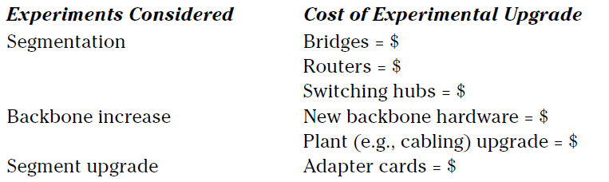
Projecting Costs

Slide 17
Figures of Merit
The key is to define what measurements are important; these are often called figures of merit.
Available tools should be examined in light of the following questions:
Can the modeling tool provide these measurements?
Can these measurements be extracted from the network (for validation)?
Do these measurements provide insight into users’ satisfaction?

Slide 18
Performance Metrics
In order to manage a network, its performance must be measurable and network goals must be specified in measurable metrics. Some of the more important metrics include:
queue buildup
end-to-end delay
Throughput
Jitter

Slide 19
Buffer/Queue Size
Queue buildup is an important indicator of potential congestion points.
Queue size is one of the largest factors in delays on ATM LANs.
It is also the largest contributing factor to jitter.

Slide 20
Latency or End-to-End Delay
Latency is the amount of delay introduced by a particular device or link;
end-to-end delay is the sum of all latencies experienced from source to destination.
End-to-end delay is important because many applications require a specific quality of service

Slide 21
Jitter
Information is transported from your computer in data packets across the internet. They are usually sent at regular intervals and take a set amount of time.
Jitter is when there is a time delay in the sending of these data packets over your network connection. This is often caused by network congestion, and sometimes route changes.
Essentially, the longer data packets take to arrive, the more jitter can negatively impact the video and audio quality.

Slide 22
Utilization, Throughput, and Goodput
Utilization is the amount of time a link is idle, versus the amount of time it is in use. This calculation does not necessarily show how much data is reaching the end system.
Throughput defines how much data is delivered to the end system.
Goodput includes the actual upper-layer contributions to performance, such as whether TCP received the packets in a usable amount of time.

Slide 23
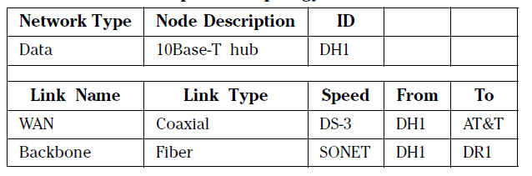
Data Collection
Once metrics are defined, the actual characteristics of the network as it exists currently must be collected. This is the first step in baselining the network.

Slide 24
Voice Network Information
Topology
Traffic-
Modeling Recommendations
Poisson distribution
Markov process

Slide 25
PHASE II: BASELINE MODEL POPULATION AND VALIDATION
Guidelines for Building Models
Step 1: Tool Use and Data Collection Validation.
Step 2: Beginning to Validate the Data Network.
Integrating and Validating Subnets
Never proceed if there are any doubts about a result
Be organized.
Understand the network.

Slide 26
PHASE III: ALTERATION OF BASELINE TO ACQUIRE DATA
When a baseline with which to compare is completed and validated, alterations can be introduced. The alterations should be introduced with the same care that the baseline was constructed.

Slide 27
Determining Remote Bridge and Router Delays
Focuses attention on techniques one can use to determine a number of quantitative metrics involved in client/ server computing via bridges and routers.
Queuing theory to illustrate various performance metrics associated with interconnection geographically separated LANs via remote bridges or routers.
Illustrates how to project queuing delays, of far more importance is the presentation of how one can use queuing theory to answer a classic network design problem. That problem is the appropriate selection of a WAN operating rate to interconnect two geographically separated LANs

Slide 28
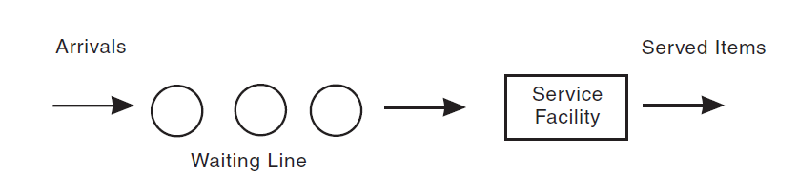
BASIC COMPONENTS OF A SIMPLE WAITING LINE SYSTEM
If the arrival rate temporarily exceeds the service rate of the service facility, a waiting line known as a queue forms.

Slide 29
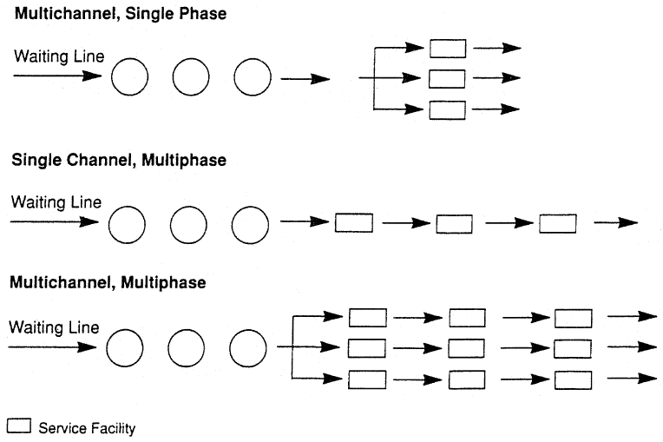
Other Types of Waiting Line Systems

Slide 30
On multichannel systems, arrivals are serviced by more than one service facility, which results in multiple paths or channels to those service facilities.
On multiphase systems, arriving entities are processed by multiple service facilities

Slide 31
Queuing theory
Distribution of arriving entities and the time required to service each arrival.
Both the distribution of arrivals and the time to service them are usually represented as random variables.
The most common distribution used to represent arrivals is the Poisson distribution

Slide 32
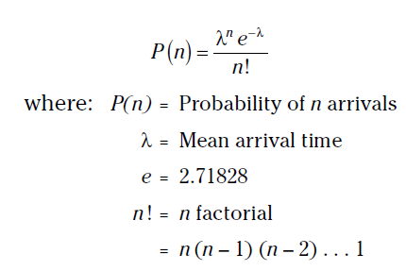
Poisson distribution

Slide 33
NETWORK APPLICATIONS
Through the use of queuing theory or waiting time analysis, it is possible to examine the effect of different WAN circuit operating rates on the ability of remote bridges and routers to transfer data between LANs.
This answers questions about the average delay associated with the use of a remote bridge or router, the effect on those delays of increasing the operating rate of the WAN circuit, and when an increase in the WAN circuit’s operating rate results in an insignificant improvement in bridge or router performance.

Slide 34
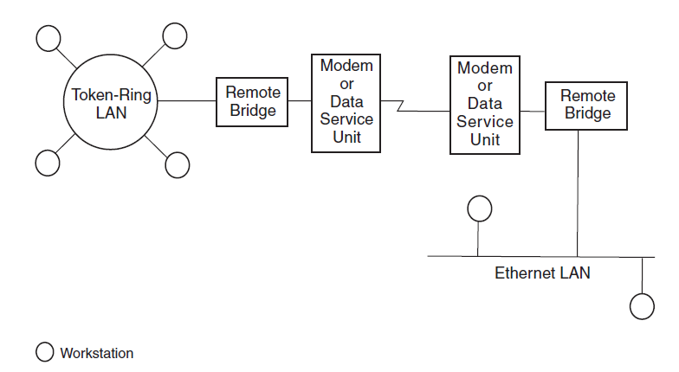
Internet consisting of two LANs connected through remote bridges

Slide 35
Example
The data communications manager has determined that approximately 10,000 frames per day can be expected to flow from one network to the other. The average length of a frame is 1250 bytes.

Slide 36
QUEUING THEORY CALCULATIONS
The 10,000-frame-per-day rate must be converted into an arrival rate.
In this case, the next assumption is that each network is active only eight hours per day and both networks are in the same time zone.
A transaction rate of 10,000 frames per eight-hour day is equivalent to an average arrival rate of 10,000/(8 * 60 * 60), or 0.347222 frames per second.

Slide 37
In queuing theory, this average arrival rate (AR) is the average rate at which frames arrive at the service facility for forwarding across the WAN communications circuit.
Monitoring has determined that the average frame length is 1250 bytes.
Because a LAN frame must be converted into a WAN frame or packet for transmission over a WAN transmission facility, whatever header and trailer information is required by the WAN protocol is added to the frame or packet.
.

Slide 38
Thus, the actual length of the WAN frame or packet exceeds the length of the LAN frame. This example assumes that 25 bytes are added to each LAN frame, resulting in the average transmission of 1275 bytes per frame
To compute an expected service time requires knowing the operating rate.
If the WAN communications circuit operates at 9600 bps, the time required to transmit one 1275-byte frame or packet becomes 1275 * 8/9600, or 1.0625 seconds.

Slide 39
This time is more formally known as the expected service time and represents the time required to transmit a frame whose average length is 1250 bytes on the LAN and 1275 bytes when converted for transmission over the WAN transmission facility.
Given that the expected service time is 1.0625 seconds, the mean service rate (MSR) can be computed easily.
That rate is the rate at which frames entering the bridge destined for the other LAN are serviced and is 1/1.0625, or 0.9411765 frames per second.

Slide 40
Two key queuing theory variables, the arrival rate and the mean service rate have now been computed.
The service rate computation was dependent on the initial selection of a WAN circuit operating at 9600 bps.

Slide 41
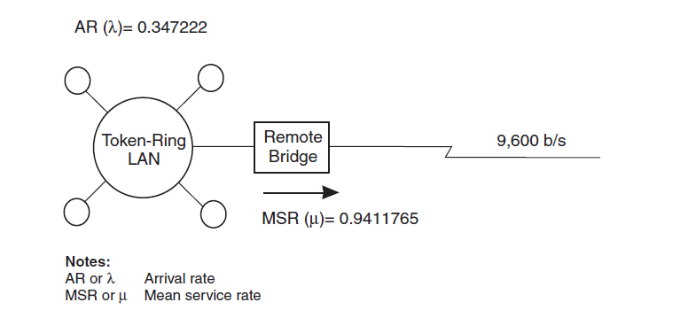
Initial computational results

Slide 42
Although the mean service rate exceeds the average arrival rate, on occasion the arrival rate results in a burst of data that exceeds the capacity of the bridge.
When this occurs, queues are created as the bridge accepts frames and places those frames into buffers or temporary storage areas.
Through the use of queuing theory, the expected time for frames to flow through the bridge can be examined and the circuit operating rate adjusted accordingly.

Slide 43
A communications network that uses remote bridges or routers corresponds to a single-channel, single-phase queuing model. The utilization of the service facility (P) is obtained by dividing the average arrival rate by the mean service rate. That is,
P=AR/MSR
= 0.347222/0.9411765
= 0.3689

Slide 44
Use of a circuit operating at 9600 bps results in an average utilization level of approximately 37 percent. In queuing theory texts, the preceding equation is replaced by
P =λ/μ
where λ is the average arrival rate and
μ is the mean service rate.

Slide 45
The utilization level of the service facility (remote bridge) is AR/MSR, so the probability that there are no frames in the bridge,Po , becomes:
Po= 1 –AR/MSR
= 1 –λ/μ
For the remote bridge connected to a 9600 bps circuit:
Po= 1 – 0.37 = 0.63
Thus, 63 percent of the time there will be no frames in the bridge’s buffers awaiting transmission to the distant network.

Slide 46
For a single-channel, single-phase system, the mean number of units expected to be in the system is equivalent to the average arrival rate divided by the difference between the mean service rate and the arrival rate.
In queuing theory, the mean or expected number of units in a system is designated by the letter L . Thus,
L = AR /(MSR – AR ) =λ/(μ –λ)

Slide 47
Returning to the network example, the mean or expected number of frames that will be in the system, including frames residing in the bridge’s buffer area or flowing down the WAN transmission facility, can be determined:
L = 0.347/(0.941 – 0.347) = 0.585
Thus, on the average, approximately 6/10 of a frame resides in the bridge’s buffer and on the transmission line.

Slide 48
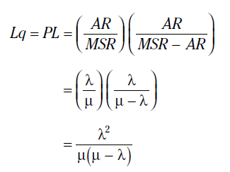
By multiplying the utilization of the service facility by the expected number of units in a system, the mean number of units in the queue or, in common English, the queue length, is obtained. The queue length is denoted by Lq and thus becomes:

Slide 49
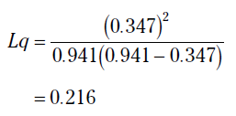
On the average, 0.216 frames are queued in the bridge for transmission when the operating rate of the WAN is 9600 bps and 10,000 frames per eight-hour day require remote bridging. There were 0.585 frames in the system, so the difference, 0.585 – 0.216, or 0.369 frames, is flowing on the transmission line at any particular time.

Slide 50

TIME COMPUTATIONS
In queuing theory, the mean waiting time is designated as the variable W , whereas the mean waiting time in the queue is designated as the variable Wq
The mean time in the system,W , is

Slide 51

For the bridged network example, the mean time a frame can be expected to reside in the system can be computed:

Slide 52
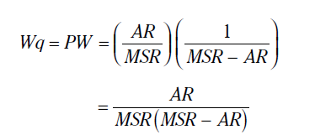
Waiting Time
The last queuing item is the waiting time associated with a frame being queued. That time, Wq , is equivalent to the waiting time system multiplied by the use of the service facility. That is,

Slide 53


In terms of queuing theory, Wq is
Returning to the bridged network example, the waiting time for a queued frame is

Slide 54
Network Baselining as a Planning Tool
PROVIDES A MECHANISM FOR DETERMINING THE LEVEL OF UTILIZATION OF A NETWORK, including its computational and transmission facilities.
Shows whether or not there is sufficient capacity available,
providing a foundation for future network measurements that can be compared to the baseline to indicate the direction of network utilization.
enables network managers and administrators to identify and respond to network capacity requirements before they become an issue

Slide 55
BASELINING TOOLS AND TECHNIQUES
SimpleView
NEWT
EtherVision
Foundation Manager

Slide 56
SimpleView
SimpleView is an easy to use and relatively inexpensive Simple Network Management Protocol (SNMP) management platform from Triticom, Inc., of Eden Prairie, Minnesota.
Through the use of SimpleView, users can retrieve statistical information maintained by Remote Monitoring (RMON) network probes.

Slide 57
SimpleView supports a Management Information Base (MIB) walk capability, shown in the MIB Walk window, that lets a user click on an MIB group to select the group starting point, or double-click on the group to explode its elements, enabling a specific element from the group to be selected for retrieval.

Slide 58
NEWT
NetManage of Cupertino, California, well known for its Chameleon suite of Internet applications, also markets a program called NEWT that can be used to monitor the use of desktop applications as well as to provide statistics on network activity associated with individual users.
NEWTMonitor on the author’s computer to monitor the number of simultaneous FTP sessions occurring over a period of time

Slide 59
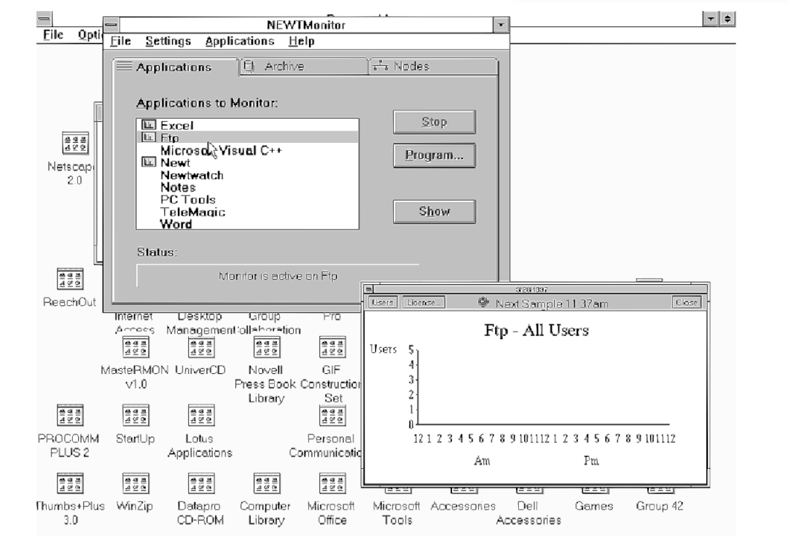

Slide 60
NEWTMonitor enables the use of specific types of TCP/IP applications. In comparison, if the network probes and network management system support RMONv2, or can be upgraded to this new version of RMON, it can be used to obtain a distribution of traffic through the application layer

Slide 61
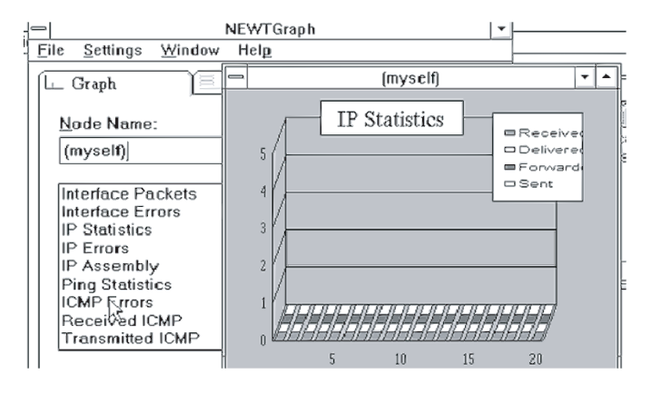
Through the use of the NetManage NEWTGraph program, graphs of different types of TCP/IP statistical information can be displayed

Slide 62
EtherVision
When checking the activity associated with an individual network, users can choose from a variety of network monitoring programs. One such program is EtherVision, also from Triticom, Inc., of Eden Prairie, Minnesota.

Slide 63
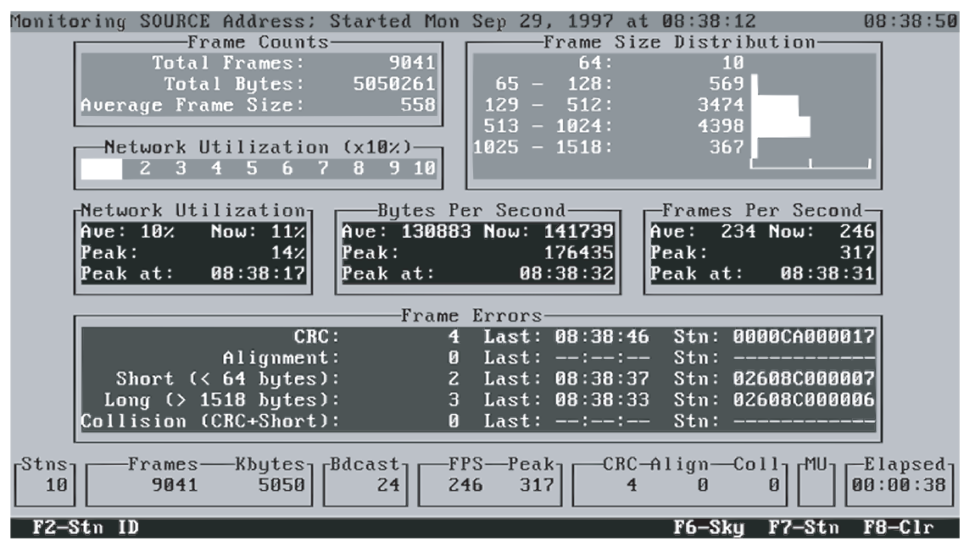
The Triticom EtherVision statistics summary display can be used to obtain information about network utilization and frame distribution.

Slide 64
EtherVision
EtherVision supports monitoring by either Source or Destination address, enabling users to build two baselines.
statistics summary presented indicates the frame count over the monitored period of time, current network utilization in the form of a horizontal bar graph, and a summary of “average,” “now” or current, and “peak” utilization displayed as a percentage, as well as the time peak utilization occurred.

Slide 65
it allows a user to run the program on a workstation connected to an Ethernet LAN and return at the end of the day to determine the peak percentage of network use as well as when the peak occurred.
EtherVision user can also set the program to generate a report that will log each period of activity over a certain percentage of network activity.
Then, using the logged report, a network manager or LAN administrator can easily determine the distribution of network utilization throughout the monitoring period.

Slide 66
EtherVision maintains a distribution of frames transmitted on the network based on their size or length, falling into five predefined intervals.
By examining the distribution of frames based on their length, users can determine the general type of traffic flowing on a network. This is possible because interactive query_x0002_response applications are generally transported in relatively short frames.
In comparison, file transfers, such as Web browser pages containing one or more images, commonly fill frames to their full length.

Slide 67
In examining the distribution of frame sizes, note that there are relatively few full-sized Ethernet frames in comparison to the total number of frames encountered during the period of monitoring. This indicates a low level of file transfer and Web browser activity occurring on the monitored network.

Slide 68
Although EtherVision provides numeric information concerning network utilization, many users prefer to work with charts that note trends at a glance.
To accommodate such users, EtherVision includes a number of built-in, which plots network utilization over a period of time.

Slide 69
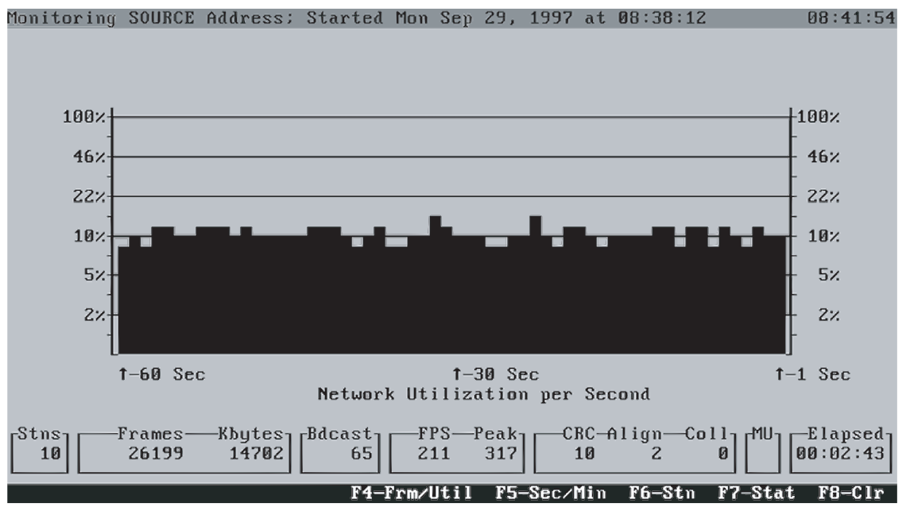
EtherVision supports the display of network utilization over a period of time, which facilitates observing the changing state of this important baseline metric.

Slide 70
Foundation Manager
Foundation Manager, a product of Network General Corporation, is a sophisticated SNMP Network Management System (NMS) platform that operates on Intel-based computers using different versions of Microsoft’s Windows operating system.
Foundation Manager was upgraded to support the emerging RMONv2 standard.
It can provide a summary of statistics through the application layer, allowing it to replace the use of multiple products to obtain equivalent information.

Slide 71
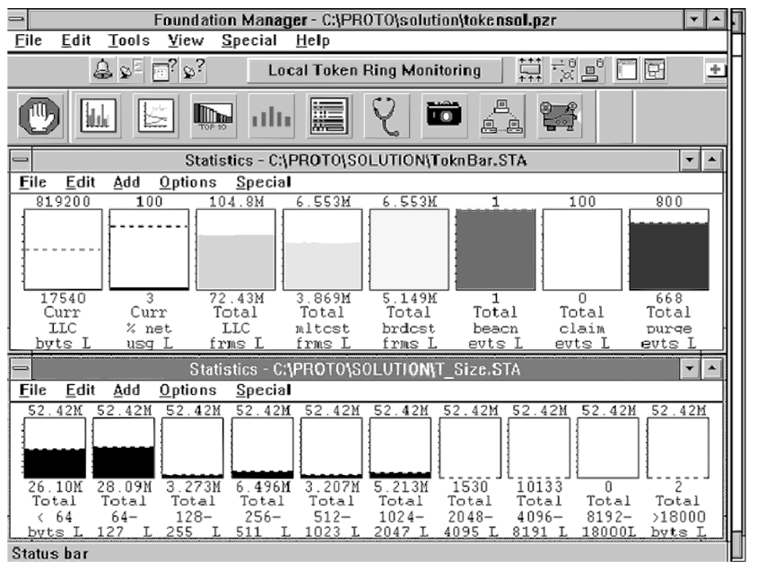
Using Network General’s Foundation Manager to monitor the distribution of frames by length and type on a Token Ring network.

Slide 72
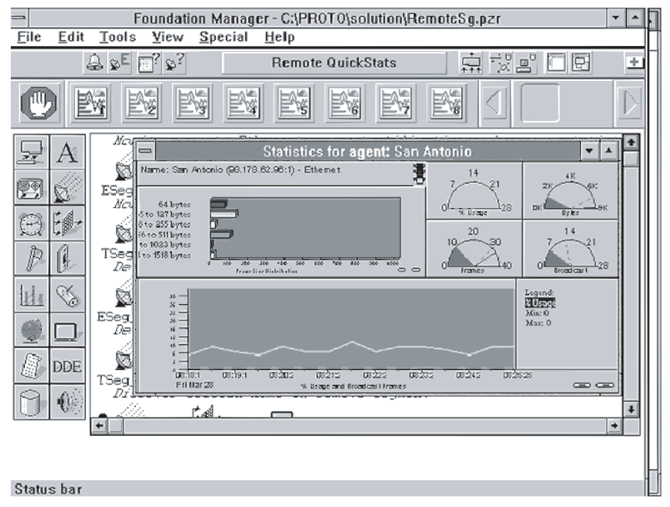
The Foundation Manager QuickStats display provides users with the ability to visually note important network baseline parameters both in real-time and over a period of time.

Slide 73
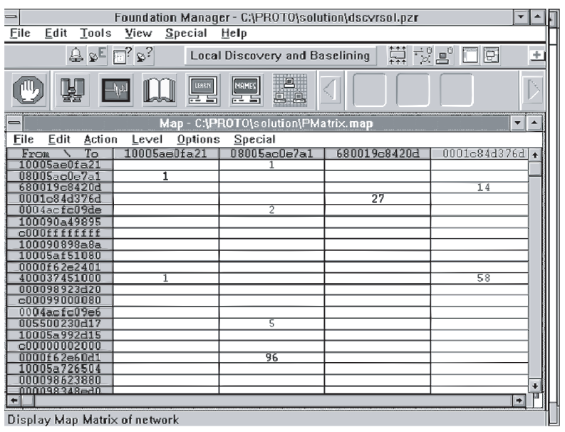
The local discovery and baselining capability of Foundation Manager enables the flow of data between stations to be identified

Slide 74

Thank you

